Slide 1
Support Vector Machine (SVM)

Slide 2
Support vector machine (SVM) are supervised learning models with associated learning algorithms what analyze data and recognize pattern used for classification and regression analysis.
Basic SVM only support to classify 2 classes.
Multiclass SVM: assign labels to instances by using support vector machines, where the labels are drawn from a finite set of several elements.
This approach is extend of basic SVM (binary classification):
One-versus-all: Using binary classifiers with between one of the labels and the rest. The result calculate by winner-takes-all, in which the classifier with the highest output function assigns the class.
One-versus-one: between every pair of classes. The result calculate by max-wins voting strategy, in which every classifier assigns the instance to one of the two classes, then the vote for assigned class is increased by one vote, and finally the class with the most votes determines the instance classification.
In this project, we use SVM multi-class with One-versus-all method.
Reference:
http://en.wikipedia.org/wiki/Support_Vector_Machine
http://www.cs.cornell.edu/people/tj/svm_light/svm_multiclass.html
Notes:
Regression analysis: phan tich hoi quy

Slide 3
Algorithm description:
Extract features of image
Compare these features with the features of the model and get the best matched rate model (SVM multi-class One-versus-all)

Slide 4
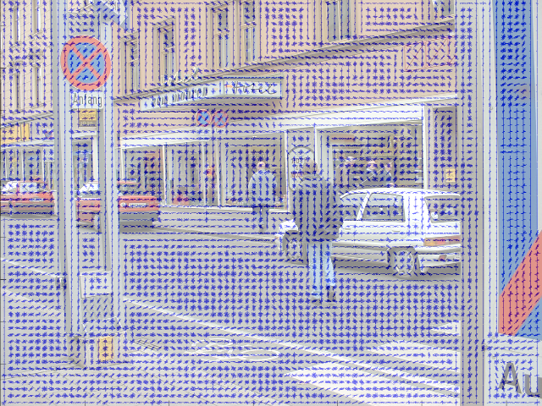
Extract feature of image: Histogram of oriented gradients (HOG) features. The technique counts occurrences of gradient orientation in localized portions of an image.
Reference: http://en.wikipedia.org/wiki/Histogram_of_oriented_gradients
HOG features

Slide 5
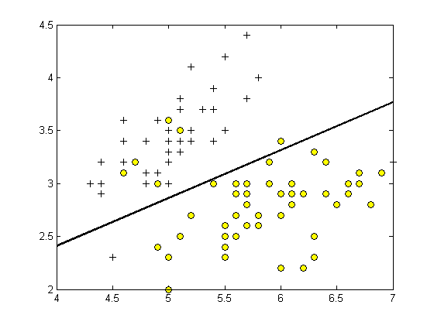
SVM classifier: Base on features SVM classifier can calculate the rate that match with model and give the candidate model for object
SVM classifier

Slide 6
Example for laptop - smartphone classify using SVM
 | Weight (kg) | Screen Size (inch)
Laptop 1 | 2.7 | 15.6
Laptop 2 | 2.3 | 14
Smartphone 1 | 0.163 | 5
Smartphone 2 | 0.124 | 4

Slide 8
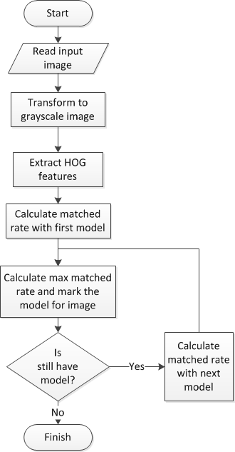

Slide 9
Performance
With image resolution: 800x460px
Web module: Ubuntu 13.10 with core i3 M350 2.27GHz, 3GB Ram
Best time to run traffic sign recognition: 0.013s
Worst time to run traffic sign recognition: 0.016s
Recognition accuracy (good condition):
Figure 73: Traffic Sign Recognition Accuracy

